Slide 1
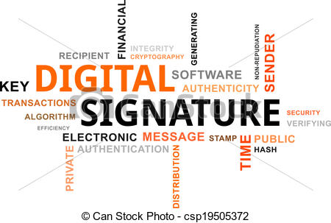

Slide 2
Introduction
Used for communication to verify
Authentication of sender/data origin
Integrity of the message received
Non-repudiation private key for E & public key for D
Identification of doc or message etc.
For interchanging data electronically

Slide 3
Implementation
Scheme has the following 3 algorithm
Key generation
Signing
Verification
It includes
MAC
Hash values of message
Digital pen pad device

Slide 4
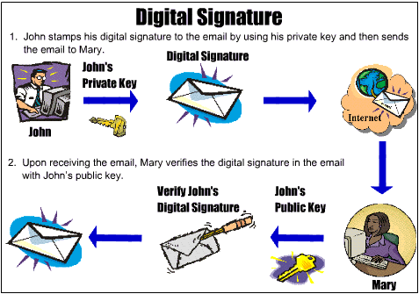

Slide 5
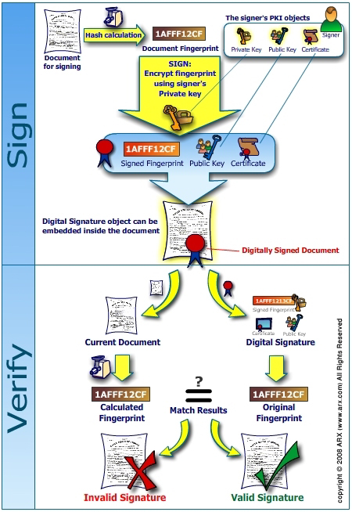

Slide 6
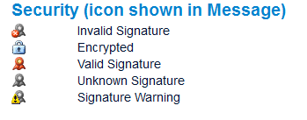

Slide 7



Slide 8
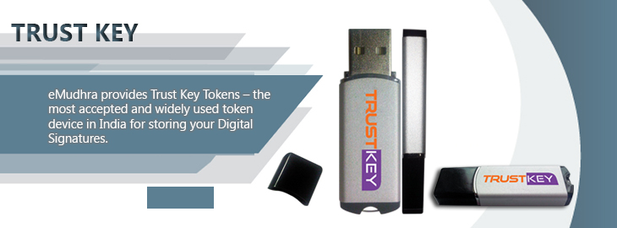


Slide 9

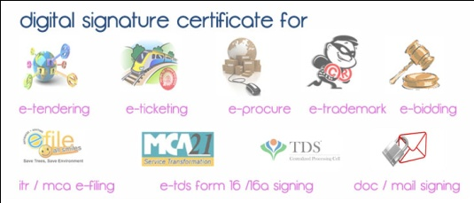

Slide 10
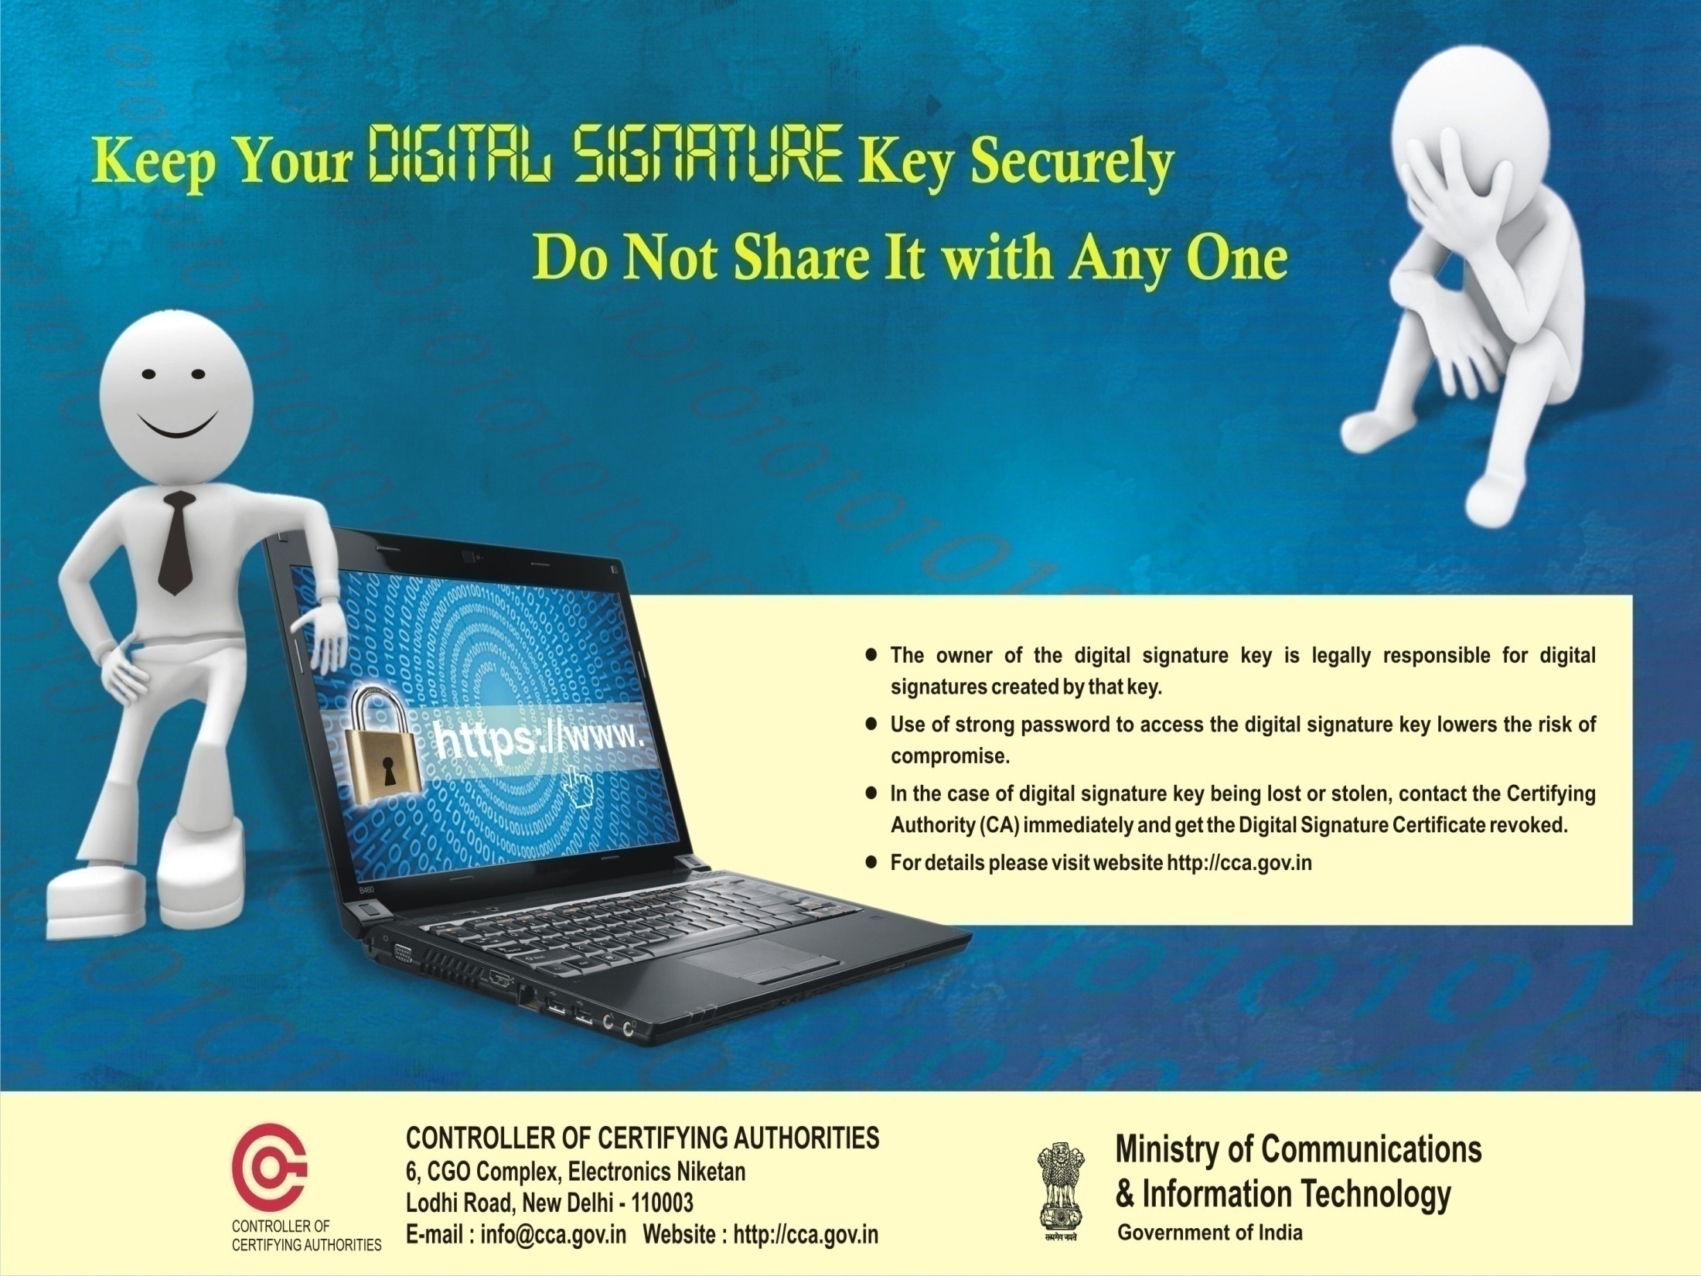

Slide 11
Digital Signature Standard
Digital Signature Algorithm
In 1991, NIST proposed DSA to be used in DSS (FIPS PUB 186)
Adopted as a standard in 94
In 96, minor revision was issued
In 2000, standard was expanded further
SHA-1
DSA v/s RSA
Free & license
DS & DS + Encryption
Strength Of Algorithm
Computer Security Resource Center NIST(csrc.nist.gov)
Federal Information Processing standard

Slide 12
RSA Digital Signature
MD Calculation
Signing(i.e:-DS Creation)
Transmission Of Original Message & DS together
Receiver calculates its own MD
De-sign digital signature(i.e:-retrieves sender’s MD)
Verification(Note:-Same Hash Algo should be used)
MD1=MD2
MD1≠MD2

Slide 13
